Slide 1
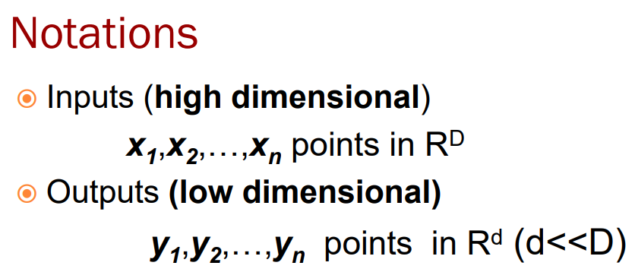
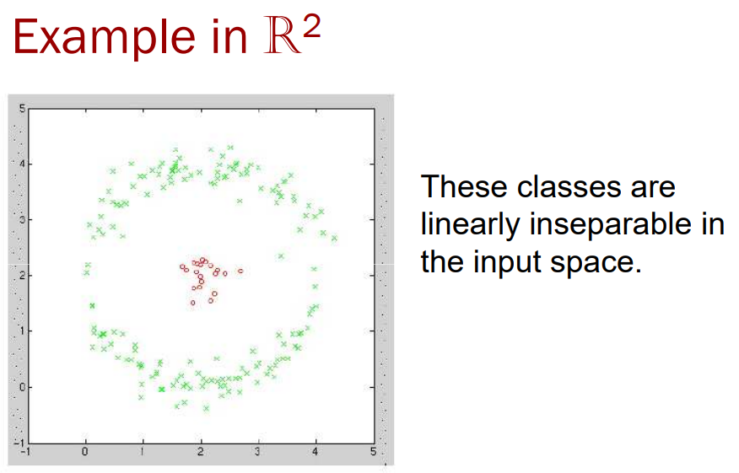
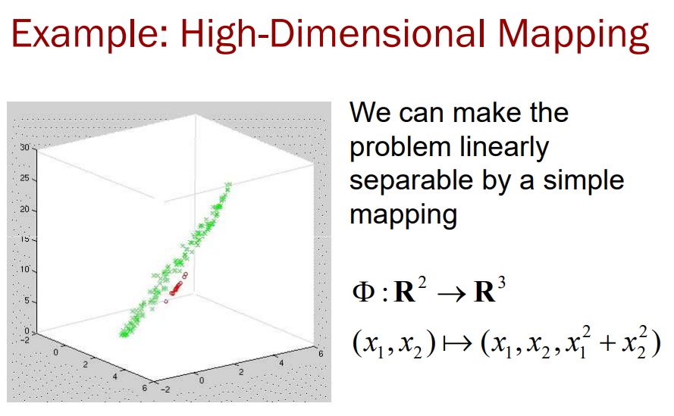
Kernel PCA: High-Dim Mapping
Often mappings which take us into a higher dimensional space than the dimension of the input space provide us with greater classification power
http://www.cs.haifa.ac.il/~rita/uml_course/lectures/KPCA.pdf

Slide 2

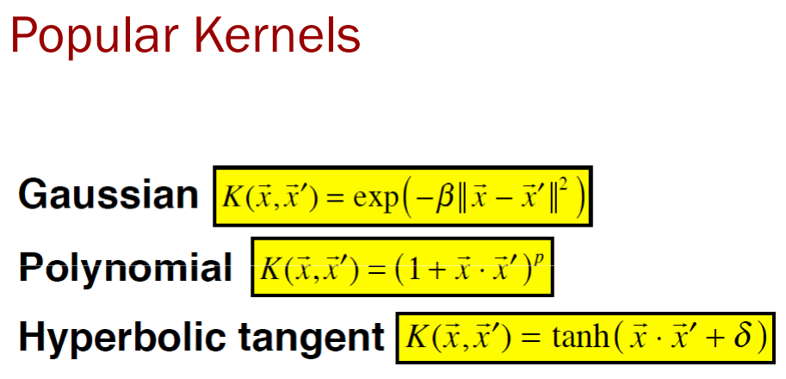
Kernel PCA: Kernel
kernel 에 대한 설명
High-dimensional mapping can seriously increase computation time
Can we get around this problem and still get the benefit of high-D?
Kernel trick allows us to construct different nonlinear versions of it
http://www.cs.haifa.ac.il/~rita/uml_course/lectures/KPCA.pdf

Slide 3
Kernel PCA: Kernel (RBF)
kernel 에 대한 설명
- RBF Kernel
[Stationary kernel]
A stationary kernel will yield the same value K(x,y) for K(x+c,y+c)
For the RBF, this is accomplished by working on the difference of the two vectors. For contrast, note that the linear kernel does not have the stationarity property.
[Isotropic]
The single-parameter version of the RBF kernel has the property that it is isotropic, i.e. the scaling by γ occurs the same amount in all directions.
This can be easily generalized, though, by slightly tweaking the RBF kernel to K(x,y)=exp(−(x−y)′Γ(x−y)) where Γ is a p.s.d. matrix.
[One parameter]
The polynomial kernel has three parameter (offset, scaling, degree). The RBF kernel has one parameter and there are good heuristics to find it.
https://stats.stackexchange.com/questions/172554/why-is-rbf-kernel-used-in-svm

Slide 4
Kernel PCA: Kernel (RBF)
kernel 에 대한 설명
As long as you don't use label information, there is not reason not to use all the information you can get from your data.
Why are quantiles of the distance a good heuristic?
-. Imagine the γ is very small, which means that the RBF kernel is very wide.
-. The other extreme situation is when the γ is large, which means that the RBF kernel is very narrow.
gamma 성질 이해 못함
https://stats.stackexchange.com/questions/23640/svm-rbf-kernel-heuristic-method-for-estimating-gamma

Slide 5
Kernel PCA: Kernel trick
kernel trick 에 대한 설명
High-dimensional mapping can seriously increase computation time
Can we get around this problem and still get the benefit of high-D?
Kernel trick allows us to construct different nonlinear versions of it
뭐가 좋다는 것인지
원리를 모르겠다
http://www.cs.haifa.ac.il/~rita/uml_course/lectures/KPCA.pdf

Slide 6
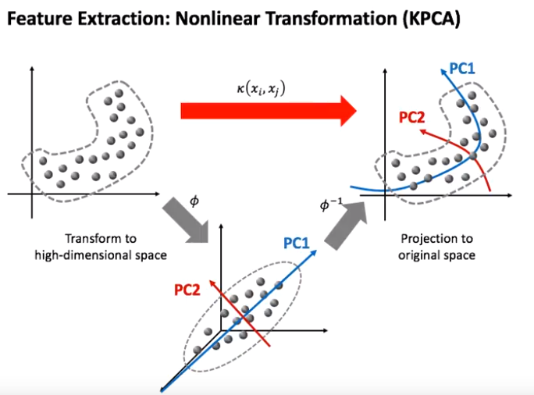
Kernel PCA: PCA
Find Principal Components
using PCA
https://www.youtube.com/watch?v=A30AFijdj4E
http://www.cs.haifa.ac.il/~rita/uml_course/lectures/KPCA.pdf

